Slide 1


The proof is
in the posting…
PROOF OF POSTING
Client Name
Campaign Name
DATE

Slide 2

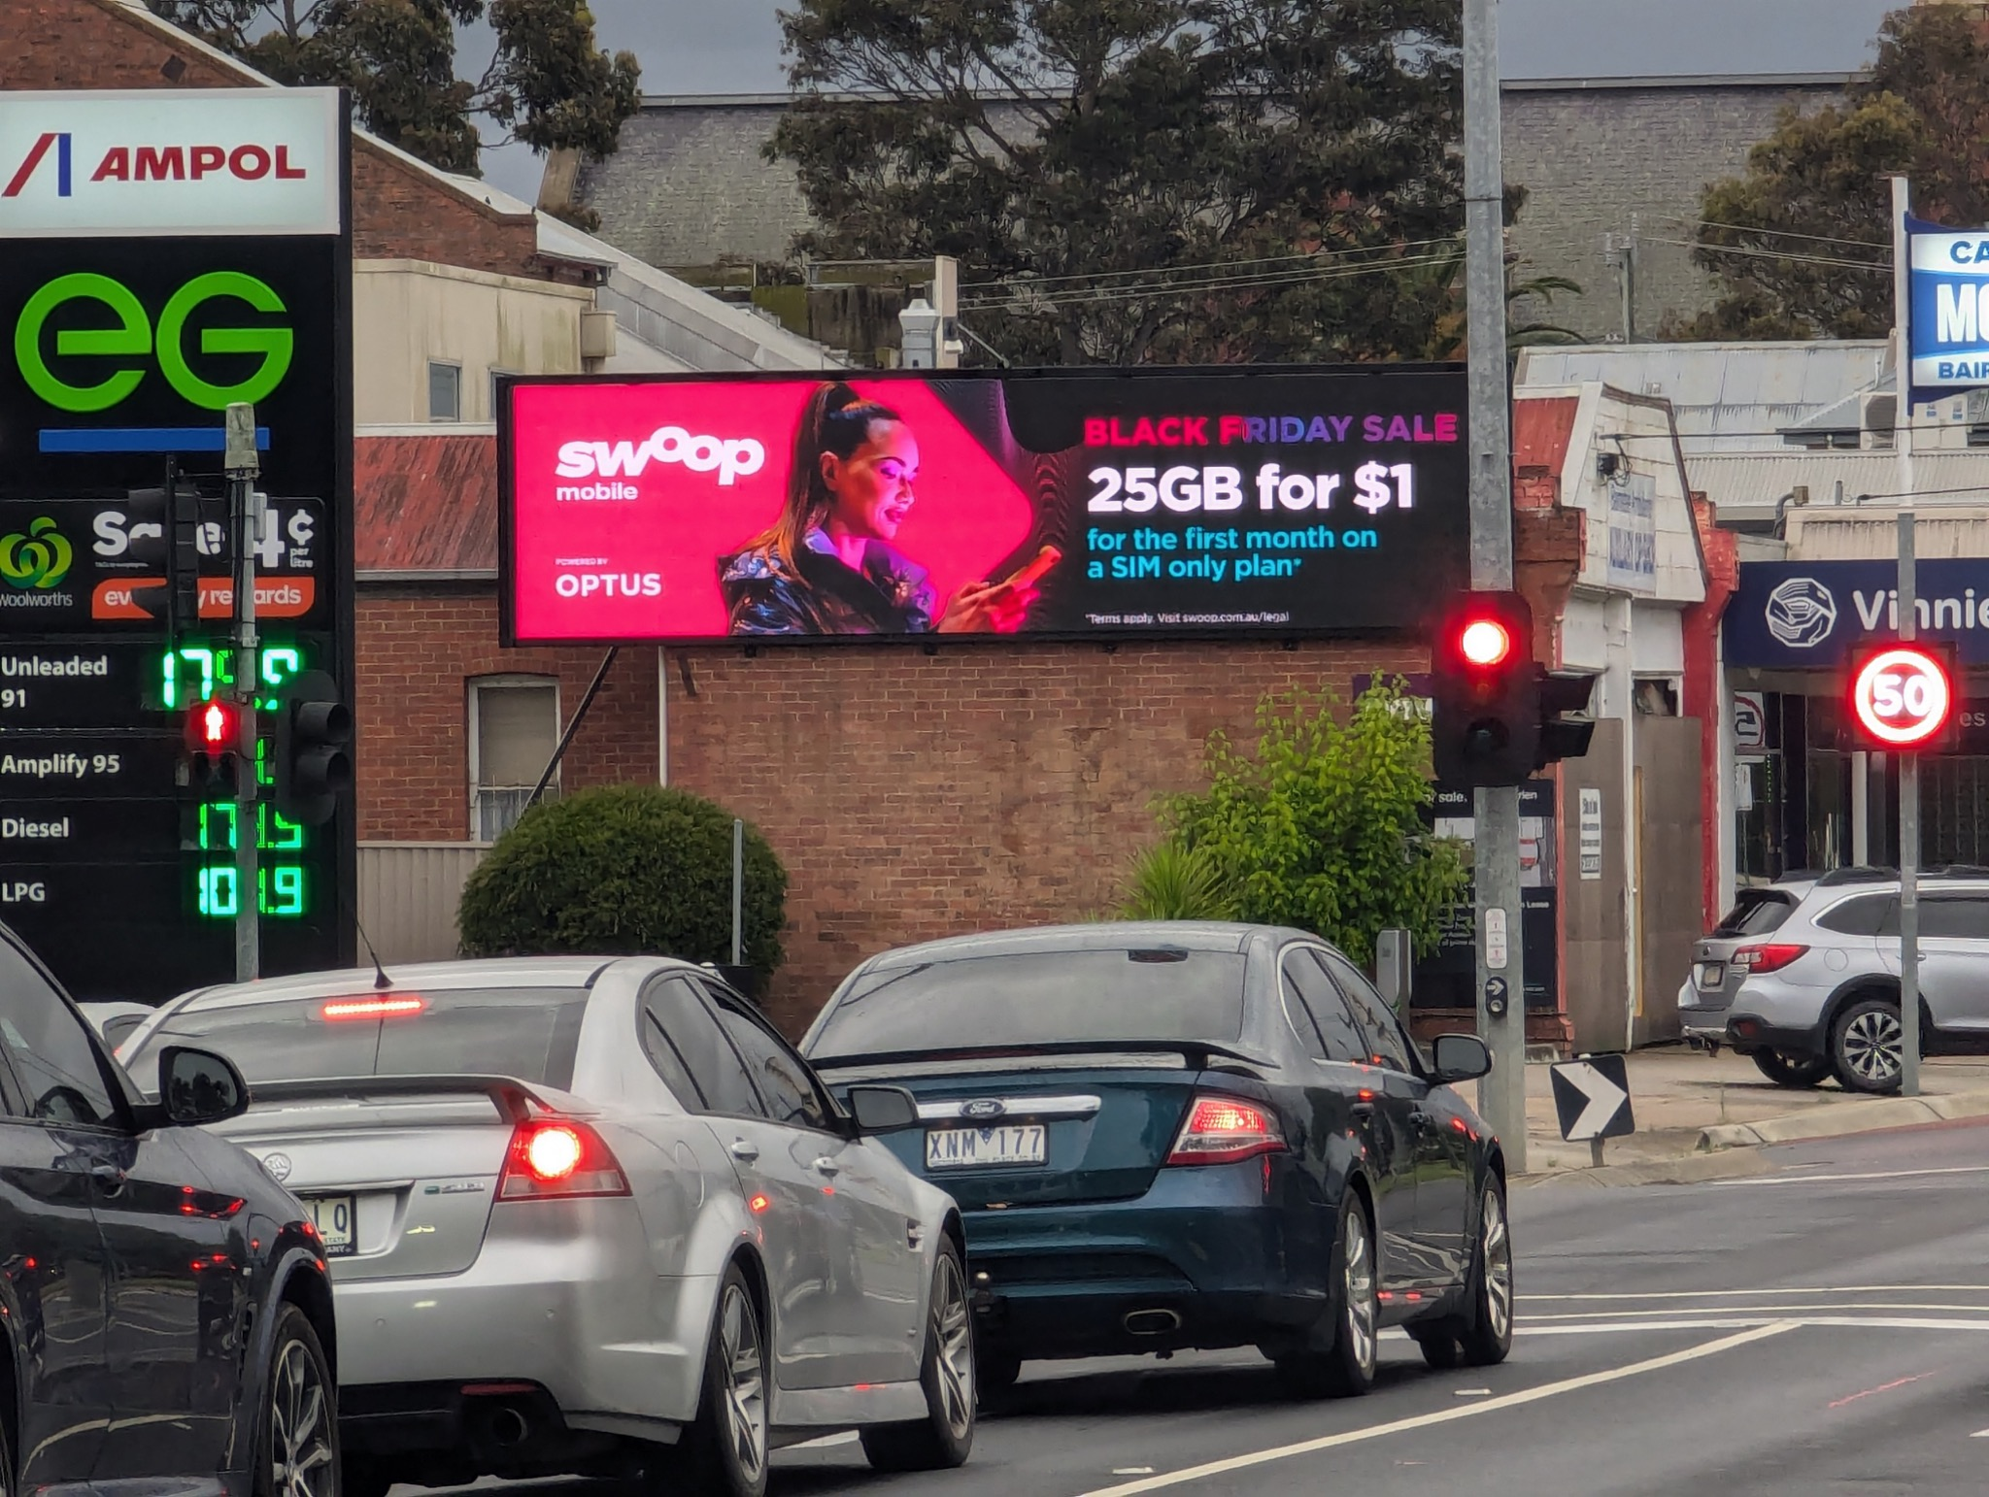
Site:
Site Name
PROOF OF POSTING
Live Date:
DD/MM/YY

Slide 3
Gotta love
rectangles
PROOF OF POSTING
Have a ripper day.
Onya!

